Slide 1
The Data Marketplace Survey Revisited
Davide De Rosa
davide.derosa@studio.unibo.it
LM in Informatica
A.A. 2024/25

Slide 2

Introduction
Nowadays, Data has become a tradable commodity.
Recognizing this, data providers have established platforms for buying, selling, or exchanging data.

Slide 3

Introduction
This process is driven by several factors:
High-quality information enables accurate decision-making, directly benefiting company revenues.
Such reliable data can be difficult to source.
This presents a business opportunity with significant potential.
Data Marketplaces aim to address this challenge.

Slide 4
Data Marketplaces History’s
In the early 1990s, shortly after the advent of the Web, a new category of professionals emerged as
Information Intermediaries.
These intermediaries were tasked with conducting searches on behalf of others for a fee. They would scour the Web for relevant information and provide the results to their clients.
The term data marketplace was likely first introduced in 1998 by Armstrong and Durfee. They developed a model for the exchange of information between digital libraries.

Slide 5
Data Marketplaces History’s
Advancements in technology and the abundance of data have led to the emergence of numerous modern data marketplaces. These platforms act as intermediaries for buying and selling data, often processing, aggregating, and reselling data found on the Web.
They provide significant value by addressing two key challenges:
Aggregating scattered data into cohesive, refined datasets, making it more accessible to customers.
Standardizing access mechanisms and formats across diverse datasets, saving customers time and money.

Slide 6
Purpose of the three surveys
Surveying and comparing different marketplaces and vendors is an essential starting point for analyzing and gaining a deeper understanding of this evolving field.
By examining the current state of the market, researchers can begin to grasp its underlying dynamics, including how it operates and adapts to change.
This process also lays the groundwork for identifying trends that may shape the market in the future, enabling a more comprehensive understanding of its trajectory.

Slide 7
Classification Framework for D.M.
A Classification Framework for Data Marketplaces is based on later research conducted by the authors of the surveys, which build upon earlier findings and provide a deeper exploration of the topic.
Understanding the rise and development of data marketplaces is crucial for comprehending how this market is evolving and how it functions.
By systematically gathering and evaluating the characteristics of these platforms, researchers can gain a clearer picture of their structure, challenges, and potential.
Furthermore, the lack of distinct, universally accepted definitions for these types of markets creates ambiguity, making it all the more important to conduct thorough research to establish clearer, more consistent frameworks.

Slide 8
Classification Framework for D.M.
Neo-Classical economics views marketplaces as both physical or virtual spaces where market activities take place.
According to this perspective, we can give two definitions.
Markets: concrete place where the interactions of buyers and sellers determine the price and the quantity of a good or a service. The focus is on a single product.
Marketplaces: for a given good is the explicit place of encounter in terms of time and location where market participants prepare and execute transactions. It provides the infrastructure for trading.

Slide 9
Classification Framework for D.M.
The market serves three different functions:
Institution: a market, as an institution, consists of a set of rules that govern the behavior of participants, assigning roles such as sellers, intermediaries, and buyers. These rules set expectations and protocols for how agents should behave, while also providing a medium for trade, helping participants meet their exchange goals.
Transaction
Pricing mechanism

Slide 10
Classification Framework for D.M.
The market serves three different functions:
Institution
Transaction: a market is defined by the total of all transactions that take place within it. These transactions are typically broken down into four phases:
Information phase: agents gather information on products and express intentions to trade through bids and offers.
Negotiation phase: the product, contract terms, and price are negotiated and finalized into a contract.
Transaction phase: the contract is fulfilled, and the commodity is exchanged.
After-sales phase: customer service plays a key role in enhancing satisfaction and ensuring long-term commitment.
Pricing mechanism

Slide 11
Classification Framework for D.M.
The market serves three different functions:
Institution
Transaction
Pricing mechanism: markets serve as mechanisms where buyers and sellers interact to set prices, which act as the balancing force that coordinates their actions. Prices also signal the conditions of exchange to market participants. The pricing mechanism is closely related to the efficient market hypothesis, which suggests that when supply and demand are balanced at an optimal price, the allocation of goods becomes Pareto-optimal, maximizing social welfare.

Slide 12
Classification Framework for D.M.
The rapid development of information and communication technology (ICT) has enabled the creation of virtual marketplaces where products, services, and information can be traded, much like traditional goods.
Notably, data, in various forms, has become a new category of tradable goods. ICT has also led to more flexible pricing and faster transactions, with automation of information processing significantly increasing information production.
However, this shift presents challenges in defining electronic markets, as no universally accepted definition exists. The variety of interpretations complicates research, but it's suggested that the relationship between electronic markets and marketplaces mirrors the distinction between their physical counterparts.

Slide 13
Classification Framework for D.M.
Electronic Markets: submarkets qualified by the electronic infrastructure they are based upon.
Analogously to the economic market definition, an electronic market is the abstract summary of all market-based allocation on the basis of electronic media.
Electronic markets differ from traditional markets in two key ways:
The Institutional function is more complex because the widespread nature of electronic markets makes it challenging to establish rules and common language.
Pricing mechanisms also differ. While price still serves as the main indicator of a good’s value and conditions, the composition of pricing, especially regarding transaction costs and the cost structure of virtual goods, can vary. The use of ICT typically reduces transaction costs significantly, leading to a notable decrease in the overall cost of goods.

Slide 14
Classification Framework for D.M.
An Electronic Marketplace, based on the earlier distinction between markets and marketplaces, refers to the specific platform or infrastructure that enables participants to meet and conduct market transactions in an electronic form.
However, the term is often used broadly to describe various concepts of e-commerce and market organization, or even as a synonym for electronic markets. Wang and Archer provide a summary of common definitions, grouping them into two main categories: electronic marketplaces as governance structures and electronic marketplaces as business models:
The business model perspective defines an electronic marketplace as a concrete virtual platform where supply and demand meet, facilitating trade between providers and customers.
The governance structure perspective, on the other hand, refers to electronic markets in a more abstract sense, without directly referencing the concept of electronic marketplaces.

Slide 15
Classification Framework for D.M.
The evaluation of data marketplaces can be enriched by examining the relationship dynamics and the distinction between market-based and hierarchical systems.
In market-based systems, competitive forces freely determine the quantity and price of goods.
Conversely, hierarchical systems, which operate within organizational boundaries, give infrastructure operators (either suppliers or demanders) an inherent advantage, with predetermined constraints on prices and participants.
Transactions between suppliers and buyers fall into either market-based or hierarchical categories. The choice between these systems depends on transaction costs and the structure of the goods involved.

Slide 16
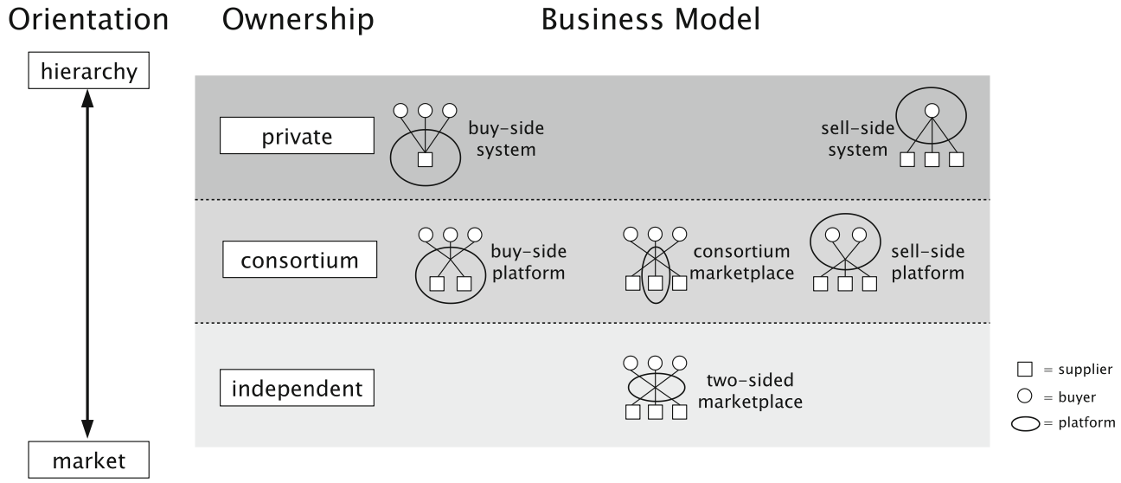
Classification Framework for D.M.
The model places providers on a spectrum from hierarchy to market and categorizes marketplaces by ownership type:
Private ownership: operated by a single company (seller or buyer).
Consortium-based ownership: shared by a small group of companies within the same industry.
Independent platforms: neutral marketplaces without ties to sellers or buyers.

Slide 17
Classification Framework for D.M.
This ownership structure leads to six business models:
Hierarchy level: privately owned platforms function in closed systems, facilitating procurement or sales for a single company, with one-to-many or many-to-one relationships.
Intermediate level
Market level

Slide 18
Classification Framework for D.M.
This ownership structure leads to six business models:
Hierarchy level
Intermediate level: consortium-based platforms feature many-to-few or vice versa relationships. Entry is theoretically possible but typically restricted to members of the consortium
Market level

Slide 19
Classification Framework for D.M.
This ownership structure leads to six business models:
Hierarchy level
Intermediate level
Market level: many-to-many platforms are independent intermediaries with minimal entry restrictions. However, some many-to-many platforms, where operators also trade their goods, lack neutrality and resemble consortium platforms due to bias toward the operator’s interests.

Slide 20
Classification Framework for D.M.
This model bridges the gap between overly complex theoretical frameworks and overly simplistic models. It simplifies analysis while maintaining explanatory depth, providing a practical tool for empirical studies.
Also, to classify data marketplaces within the neo-classical framework for markets, some criteria are identified to distinguish them as electronic marketplaces:
Primary Business Model: the provider must primarily focus on offering data and/or related services to qualify as a data marketplace.
Infrastructure Requirements: data marketplaces must provide a platform that enables users to upload, browse, download, buy, and sell machine-readable data (e.g., RDF, XML). The platform must host the data and clearly identify whether it originates from the community or the operator.

Slide 21
The Surveys
As already said before, there are three different surveys, all done consecutively. We are going to look at the first two initially, adding the results of the third later on.
The focus is on companies offering either a platform that
allows users to buy and/or sell data, providing raw data in any form, or on companies offering data enrichment tools.
The platform, or service, has to be online.
The vendors are divided in 12 categories (14 in the 2nd survey).
The categories are not mutually exclusive.
All the facts are gathered by means of a Web Search, through respective vendors Websites.

Slide 22
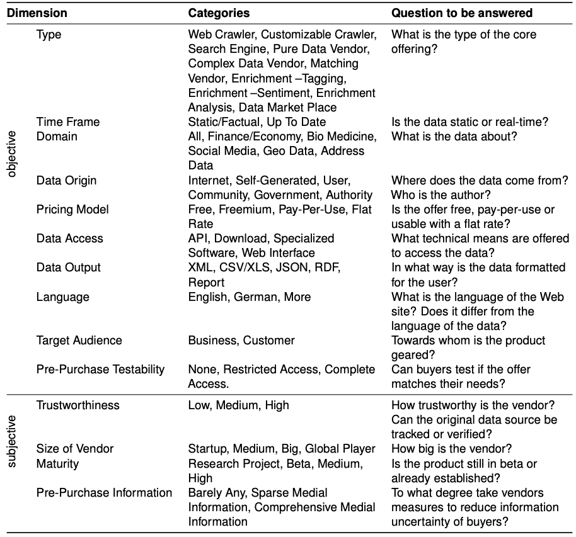
Set of Dimensions
Dimensions are divided in objective and subjective.
From the first survey, there have been added 2 dimensions:
Pre-purchase testability
Pre-purchase information
Also, some companies have since ceased operations or shifted their business focus, while new ones have been added to the latest survey.

Slide 23
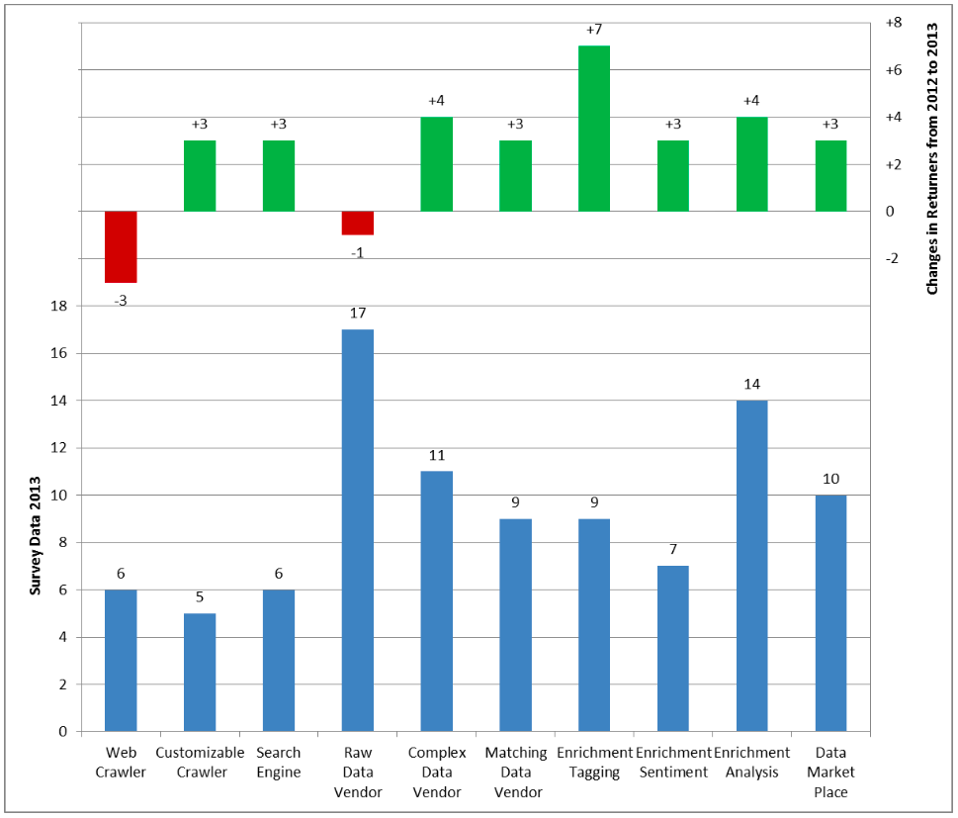
Findings - Type
The Type dimension categorizes vendors based on their core products.
Vendors offering enhanced data are becoming more prevalent, while services focused on raw or unprocessed data have slightly declined.
This trend likely reflects the growing demand for high-quality, processed data in an expanding market, where stagnation equates to falling behind.

Slide 24
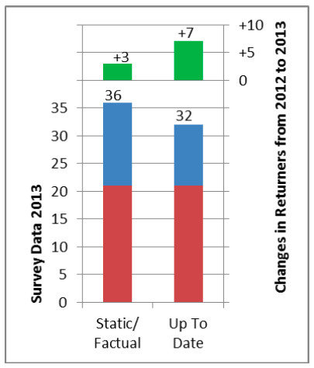
Findings - Time Frame
The Time Frame dimension categorizes data as either long-term static/factual or short-term up-to-date.
Notably, the percentage of vendors offering both types of data grew significantly, from under 20% in 2012 to about 45% (21 vendors) in 2013.
The gap between vendors offering only one type narrowed from 9 to 4, with a stronger increase in up-to-date data among returning vendors.

Slide 25
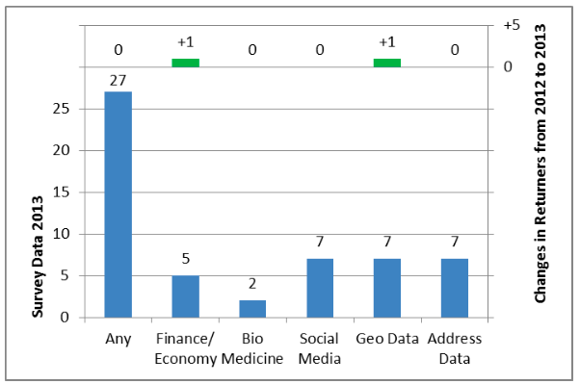
Findings - Domain
The Domain dimension identifies the original application area of the data.
Vendors in the any category, such as data marketplaces, are excluded from explicit domain counts.
Other domains are not mutually exclusive, allowing vendors to serve multiple areas. The results are consistent with the first study, with no notable changes or emerging trends observed.

Slide 26
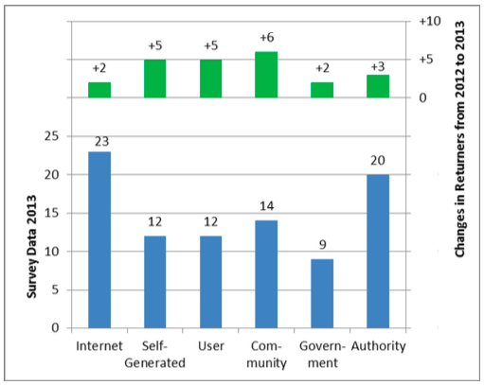
Findings - Data Origin
The Data Origin dimension classifies data by its source.
In the second survey, the most common sources remained Internet and Authority, valued for their high accuracy, completeness, and credibility.
However, there was an 80% increase among returners in data sourced from self-generated, user, and community origins.
The rise in user data, often linked to enhancement services, indicates a growing demand for adding value to existing data.

Slide 27
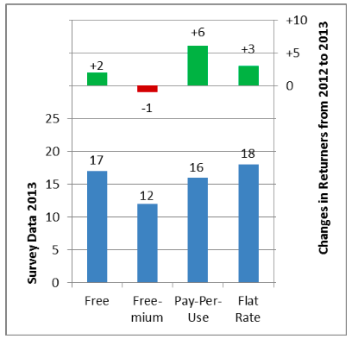
Findings - Pricing Model
The Pricing Model dimension classifies data by its pricing model.
The four pricing models identified previously remain the most common.
Most models have remained stable, except for freemium, which has declined in popularity, and pay-per-use, which has seen significant growth.
This shift, observed both among returning vendors and overall, suggests increased customer trust in the quality of purchased data and a greater willingness to pay.

Slide 28
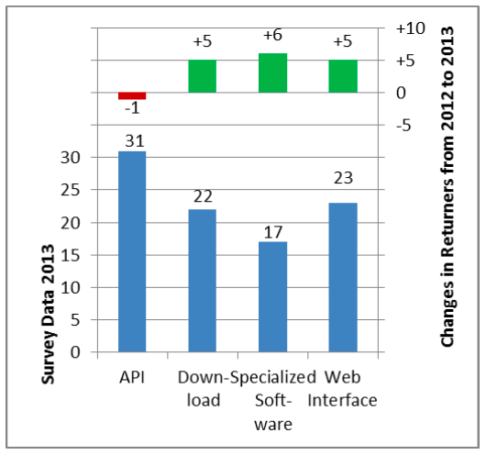
Findings - Data Access
The Data Access dimension describes how end-users obtain data from vendors.
APIs remain the most common access method but have declined in popularity compared to the first survey.
Proprietary access via specialized software saw the largest increase, though it remains the least common. This rise may reflect efforts to differentiate offerings through features like visualization or value-added services.
Additionally, 11% of vendors now offer all access types, providing customers with maximum flexibility.

Slide 29
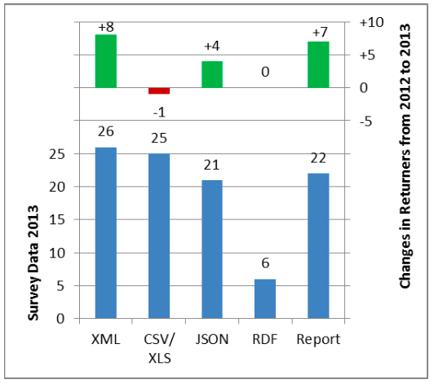
Findings - Data Output
The Data Output dimension describes how end-users receive data from vendors.
XML has surpassed CSV/XLS as the most popular data format, and with the rise of JSON, it appears that web standards are replacing traditional formats.
Two vendors even offer all data output formats. The growth in pre-formatted reports suggests that vendors are aiming to differentiate themselves and simplify data access for non-technical users, such as managers.

Slide 30
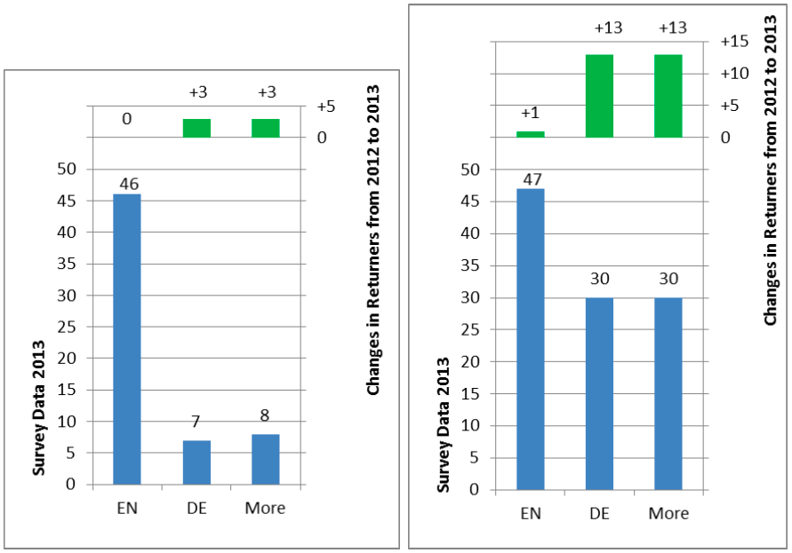
Findings - Language
The Language analysis differentiates between the language of websites and the language of the data.
As in the previous study, the figure shows that English remains the dominant website language, with only minor increases in German and other languages among returners.
However, the language of the data itself shows slight growth in English, while German and other languages have seen significant increases, indicating a rising demand for national, non-English data.

Slide 31
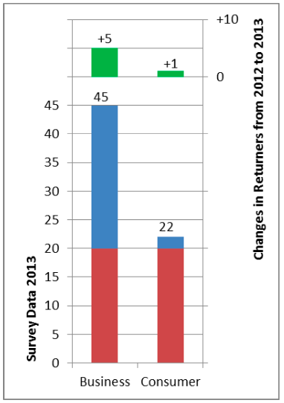
Findings - Target Audience
The Target Audience dimension distinguishes between offerings aimed at business customers (B2B) and consumers (B2C).
The figure shows that the percentage of vendors serving both categories increased from 28% to 43%.
However, more than twice as many offerings focus on B2B customers than on consumers.
Based on the changes observed between the first and the second survey, it is reasonable to conclude that data services are, and will likely remain, a B2B-centric market.

Slide 32
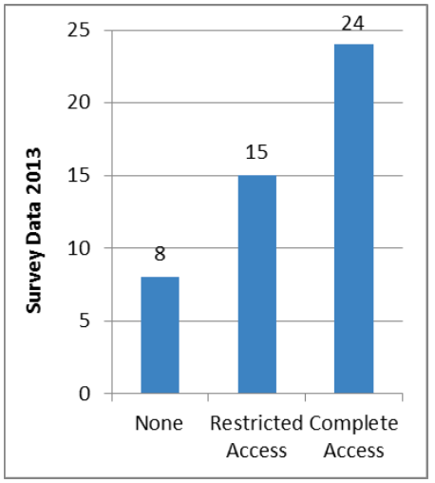
Findings - Pre Purchase Testability
The Pre-Purchase Testability dimension evaluates the extent to which data offerings can be tested before purchase.
Given that most buyers prefer as much information as possible before making a purchase, it's not surprising that over 80% (39 vendors) offer at least restricted access.
However, 17% (8 vendors) provide no access before purchase, relying on customers trusting their promises, which is surprisingly high.

Slide 33
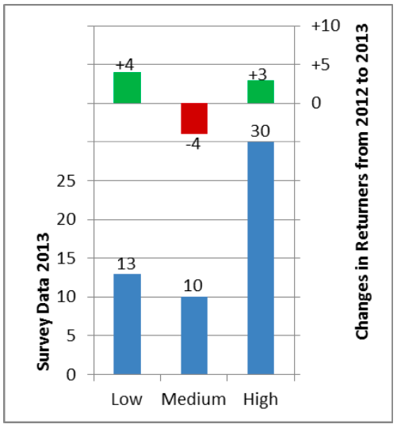
Findings - Trustworthiness
The Trustworthiness dimension evaluates the trustworthiness of vendors based on the origin and processing of their data.
Since the results are subjective and not quantifiable, they allow for multiple entries per vendor, as they may offer various services.
The figure shows no clear trend, although there is an increase in both low and high trustworthiness ratings.
Any interpretation of this pattern would be speculative at this point.

Slide 34
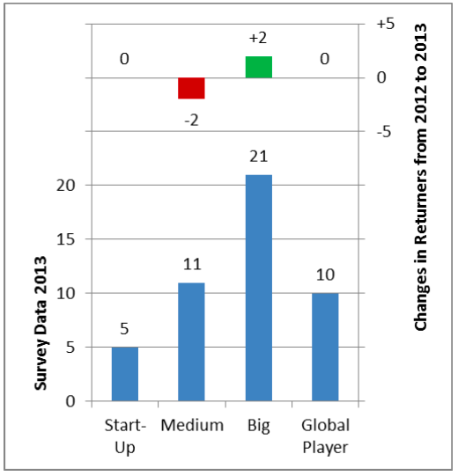
Findings - Size of Vendors
The Size of Vendors dimension classifies vendors by size based on their web presentation.
The figure shows that the distribution remains similar to the first survey, but within the returners group, there is an increase in vendor size.
In the second survey, the overall results show a stronger presence of large companies compared to medium-sized ones, while the number of startups and global players remains stable.
This suggests that the market is growing and companies are evolving.

Slide 35
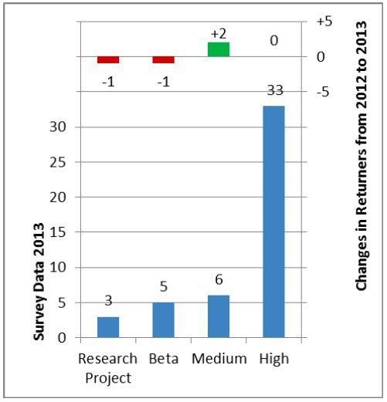
Findings - Maturity
The Maturity dimension classifies vendors by their maturity level.
Similar to vendor size, Maturity has not changed significantly since the first survey.
However, there is a slight increase in medium and high maturity levels in the overall set, with returners also showing similar trends.
The figure illustrates this, reinforcing the idea that the market and companies are growing and maturing, though at a relatively slow pace.

Slide 36
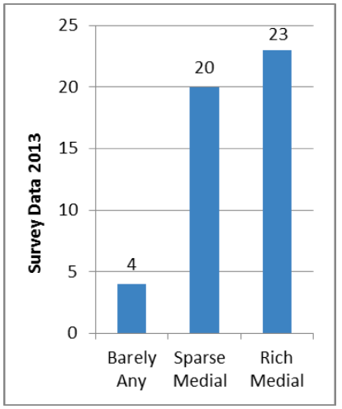
Findings - Pre Purchase Information
The Pre-Purchase Information dimension evaluates how well vendors provide information before a purchase, focusing on the extent rather than the quality of the information.
Since more information helps customers better assess a service, it is not surprising that only 3 vendors provide minimal information.
In contrast, nearly half (23 vendors) offer comprehensive media content to reduce uncertainty and assist in the purchase decision.

Slide 37
The Third Survey
The third survey has some new refined dimensions:
The Website Language dimensions is out, considered irrelevant.
The Data Language now refers to the metadata.
A new dimensions (Ownership) has been added, thanks to the Classification Framework to evaluate biases.
Also, the sample got bigger. From 47 to 72 vendors.
This new survey offers new findings, such as Trends and a new Statistical Analysis Method.

Slide 38
Statistical Analysis Method
The survey utilizes categorical variables with binary responses (positive or negative). Since some dimensions allow multiple responses, methods for multiple response categorical variables (MRCVs) are used for analysis.
The study combines dimensions to derive insights based on their relevance, such as understanding provider behavior or assessing data commoditization.
Not all combinations yield meaningful results, with some being inherently correlated or unrelated.

Slide 39
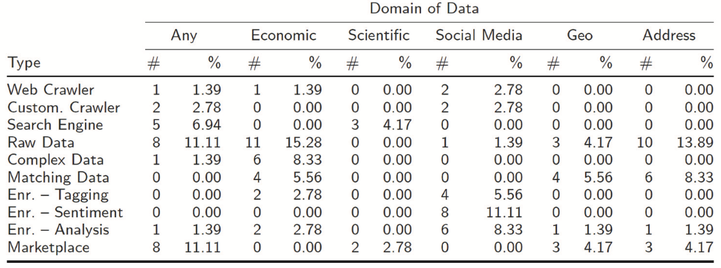
Type / Domain (1)
Examines whether certain business models are more likely to offer specific types of data.

Slide 40
Type / Domain (2)
The most common combinations are Raw Data Vendor/Economic Data and Raw Data Vendor/Address Data.
These findings align with the prevalence of Raw Data Vendor and Economic Data as frequently observed categories.
While most data domains are distributed across various business models, Scientific Data stands out due to its limited distribution.
It is sold through only two specific channels, highlighting its rarity as a standalone product and its constrained variety of providers, even when it may be indirectly included in broader categories like “any”.

Slide 41
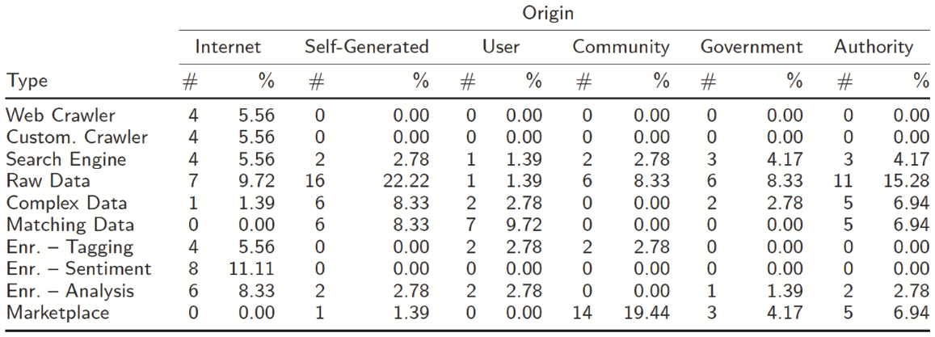
Type / Origin (1)
Investigates whether certain business models obtain data from specific sources.

Slide 42
Type / Origin (2)
Enrichment services and crawlers rely primarily on the Internet for data collection.
Marketplaces focus on community-curated data.
While it initially seems that most Raw Data Vendors generate their data in-house, only six providers rely solely on self-generated data.
The majority aggregates data from online, federal, and institutional sources, reflecting a demand for aggregated and cleaned data rather than purely proprietary datasets.

Slide 43
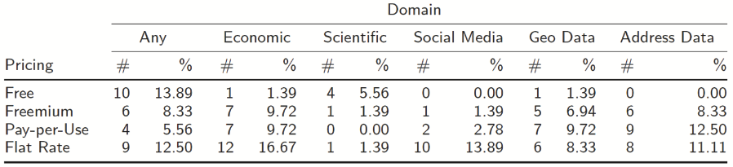
Pricing / Domain
Examines the prices for a given domain.
Specialized domain data is rarely distributed for free, except for Scientific Data, where 80% is free.
Social Media and Economic Data are often priced with flat rates, aligning with their need for regular updates.
No clear trend emerges for the any category, which shows an even distribution across pricing models.

Slide 44
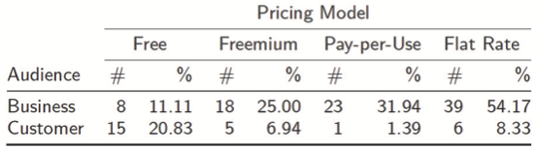
Audience / Pricing Model
Examines the prices for a given customer type.
Less than one-third of offerings for private customers are charged. Most rely on a Freemium model.
Since only 9.7% of providers target private customers exclusively, the market is heavily B2B-focused.
For business customers, fees are standard, with Freemium and Flat Rate models potentially serving as strategies to familiarize customers and leverage lock-in effects.

Slide 45
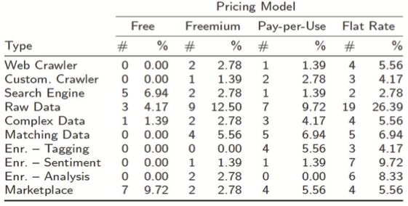
Type / Pricing Model
Examines the prices for a given type of vendor.
Different types of data providers often have distinct preferences for pricing models.
Enrichment services, which primarily offer social media data from online sources, tend to prefer flat-rate pricing.
Raw data vendors lean towards flat-rate or freemium models, emphasizing a consistent supply as a key advantage.

Slide 46
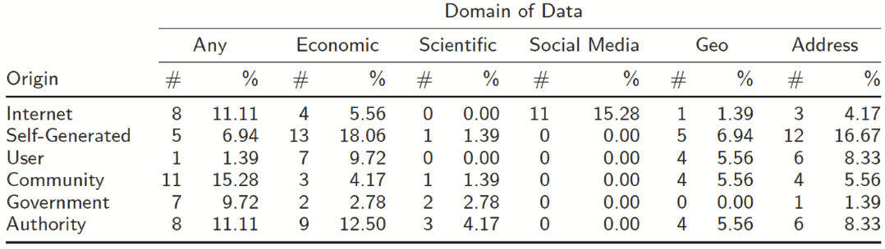
Origin / Domain
Examines where domain draw data from.
Some domains rely on diverse sources, while others are confined to specific types.
Address Data is most commonly paired with self-generated sources, reflecting limited transparency in the sourcing process.
Any data is predominantly obtained from communities, indicating minimal barriers to participation.

Slide 47
Trends (1)
When looking at the results of the surveys over the course of the last three years, five global trends can be identified:
Some provider manifestations seem to make more sense than others do.
Another common type is matching data services, which use user- and self-generated data to match addresses, geographical, and economic data. Generally, providers focus on only one category and limit themselves to only one domain and one data source.
This indicates that providers split themselves into two groups:
Hierarchical (“vertical”) providers with only a single domain offering
Intermediate (“horizontal”) platforms, where unrestricted domain data can be acquired.

Slide 48
Trends (2)
When looking at the results of the surveys over the course of the last three years, five global trends can be identified:
There's an increase in the use of self-generated data, which highlights its growing significance in differentiating providers.
Providers who specialize in a single domain tend to charge for their data rather than offering it for free, especially in the B2B market.
In 2013, there was a notable rise in the use of self-generated, community, and user sources compared to Internet sources.
This trend suggests providers are moving away from reselling publicly available data and focusing on unique, individualized data sources to stand out in the market.

Slide 49
Trends (3)
When looking at the results of the surveys over the course of the last three years, five global trends can be identified:
Flat rates have gained significant traction over pay-per-use models, which were previously seen as equal in earlier surveys. Providers prefer flat rates for their steady revenue stream, often combined with freemium models to minimize uncertainty and capitalize on lock-in effects.
Pay-per-use models have not yet reached the sophistication needed to prevent exploitation, which may deter both providers and customers.
Customers favor simpler pricing models and dislike granular ones that limit flexible data exploration.
The success of subscription-based models in sectors like entertainment (e.g., Netflix, Spotify) suggests that flat-rate models will continue to dominate in data-related services as well.

Slide 50
Trends (4)
When looking at the results of the surveys over the course of the last three years, five global trends can be identified:
The data market is still largely dominated by hierarchical ("vertical") relationships, where providers control specific data offerings.
The market shows a low number of intermediaries, indicating that its efficiency is still limited.
Data products remain highly differentiated, suggesting that there is a lack of standardization and significant variation in offerings.

Slide 51
Trends (5)
When looking at the results of the surveys over the course of the last three years, five global trends can be identified:
Over recent years, the data access landscape has shifted from APIs to Web exchange formats like JSON and XML, with CSV data formats surpassing others this year. There could be two possible explanations:
Processed Data: the rise in report formats might indicate a focus on offering more processed data.
Non-Technical User Accessibility: alternatively, the prevalence of raw data vendors could suggest a trend toward making data more accessible to non-technical users.
The data market seems to be moving towards mainstream adoption, targeting non-technical businesses and users, with many providers offering multiple access options, though focusing on standard formats like reports or CSV to reduce complexity.

Slide 52
Conclusions
The evolution of the data market over time presents a notable shift in the size and composition of its providers. Initially, the market was dominated by large, established companies, often from the software and hardware industries. These companies had the resources to overcome high entry barriers, quickly securing a significant market share.
However, as the market matured, these entry barriers began to lower, allowing new players, particularly startups, to enter and establish themselves. This shift has been reflected in the survey data, which now includes a significant number of startups, highlighting the increasing diversity in the market.
The growing presence of startups doesn’t contradict the overall trend of a maturing market. In fact, their emergence suggests that the data market has become more stable and established, with intermediaries now playing a central role in data trading.

Slide 53
Conclusions
In addition to this shift, the concept of data commoditization comes into play, especially when considering the two groups of data consumers: those seeking highly specific, individualized data, and those requiring data of consistent quality.
For the former group, commoditization may not be desirable, as highly specialized data is unlikely to follow a standardization path.
On the other hand, for the latter group, data that is more standardized and consistent would be more conducive to commoditization, likely increasing its exchange on marketplaces.
This could lead to a more competitive market for standardized data, further driving down implementation costs and increasing accessibility.
Ultimately, the ongoing development of intermediary platforms is likely to be a key indicator of this commoditization process. As competition and commoditization are closely linked, their simultaneous growth could accelerate the standardization of data, shaping the future landscape of the data market.

Slide 54
References
Schomm, F., Stahl, F., & Vossen, G. (2013). Marketplaces for data: an initial survey. ACM SIGMOD Record, 42(1), 15-26.
Stahl, F., Schomm, F., & Vossen, G. (2014). The data marketplace survey revisited (No. 18). ERCIS Working Paper.
Stahl, F., Schomm, F., Vossen, G., & Vomfell, L. (2016). A classification framework for data marketplaces. Vietnam Journal of Computer Science, 3, 137-143.
Stahl, F., Schomm, F., Vomfell, L., & Vossen, G. (2015). Marketplaces for digital data: Quo vadis? (No. 24). ERCIS Working Paper.

